Slide 1
Potential Barriers & Solutions to P-J Biomass Utilization
Bill Carlson, Principal
Carlson Small Power Consultants
P-J Restoration & Utilization Summit
December 8, 2010
Las Vegas, NV

Slide 2
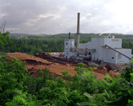
Barrier No. 1
Current markets for P-J removal are sporadic, low volume, low value
Build a “base” market with a guaranteed revenue stream over long period utilizing biomass power or CHP
Solution
Source: nationalatlas.gov

Slide 3
Barrier No. 2
Publicly owned utilities in P-J region do not represent ready market for output due to small size, low bulk power cost, no RPS requirement
Solution
Use local utility, not as purchaser, but to move power to NV Energy
Local utility recognizes line loss savings, reliable nature of biomass
Local utility recognizes economic development potential

Slide 4
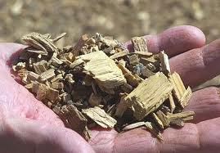
Barrier No. 3
Even delivered to NV Energy, value of power under Nevada’s Renewable Portfolio Standard may not move project forward
Solution
Similar to solar “carve-out” in RPS, establish recognition for biomass from P-J.
Recognize biomass thermal use within both RPS and Portfolio Energy Credit (PEC) programs

Slide 5
Barrier No. 4
Do not want to miss future higher valued uses by locking in low value, but guaranteed, long term use
Solution
Resource offering could include flexibility to expand as other markets develop, with higher returns to landowner from expanded acreage
Develop flexibility in power sales contract via high on peak/low off peak values for power

Slide 6
Barrier No. 5
A small standalone biomass power facility is more expensive, less efficient
Find or plan for a sizeable thermal host for facility
Mining industry for ore roasting
Nevada State Prison at Ely
Anchor for “green” industrial park
Obtain RPS Credit for thermal portion as well as electrical
Solution

Slide 7
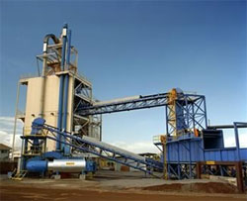
Barrier No. 6
Solution
Resource offering too
small to develop plant
large enough to
compete in electric
marketplace
Coordinated agency response with landscape level approach
Develop similar model program for private landowners
Above all, recognize this may be opportunity to lower cost/expand scope when designing offering

Slide 8
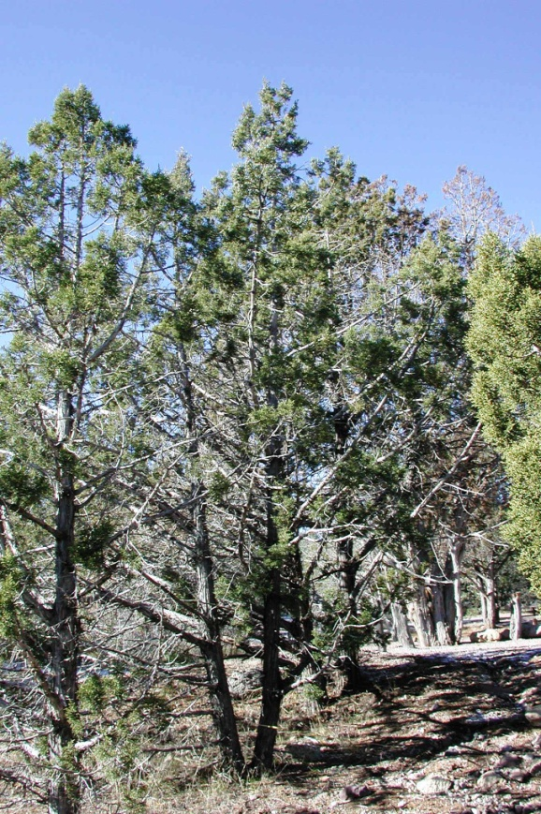
Barrier No. 7
Current resource offering tools too short in duration to minimize cost for developer
Solution
Need “special” 20 year authority to allow developer debt service to match power contract length

Slide 9
Barrier No. 8
“Homework Assignment- Extra Credit”
Biomass power or CHP not fully recognized at federal level
Solution
In reauthorization of incentives, give biomass full production tax credit
Be sure biomass definition in federal RPS allows P-J activity to count
Allow thermal credit to count in federal RPS

