Slide 1


Making P-J Biomass Utilization Pencil
Tools & Incentives
Bill Carlson, Principal
Carlson Small Power Consultants
P-J Restoration & Utilization Summit
December 8, 2010
Las Vegas, NV

Slide 2
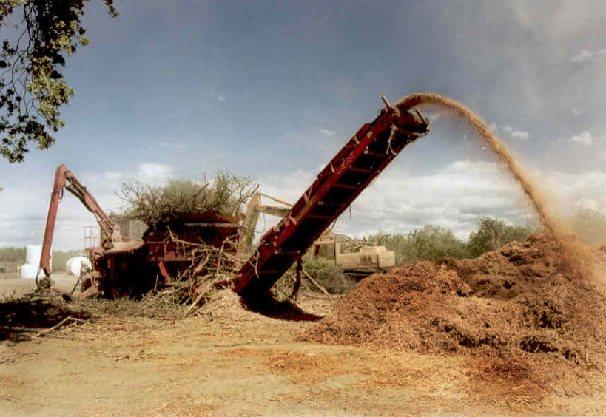
Improving the Base Case
10 MW Project, no steam sales
$95/MWH electric sales price in 2013
Federal PTC, state sales & property tax reductions
6% Construction, 4% long term debt interest
30% Equity, 15% return
Pays $25/BDT for fuel
  -Chipping/delivery cost of $20

Slide 3
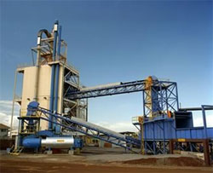
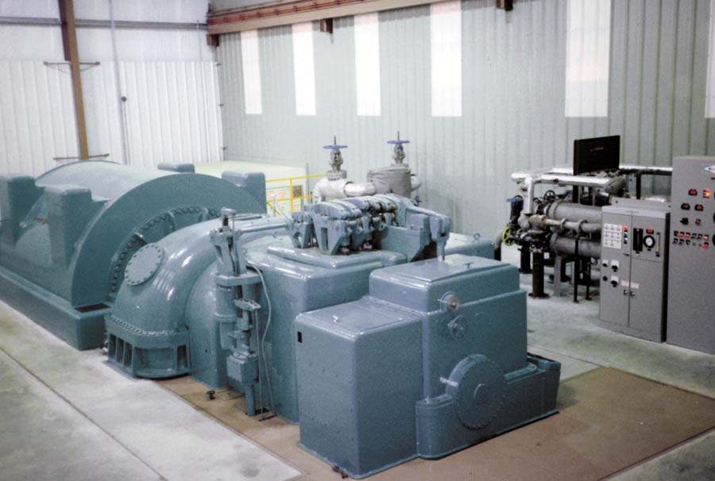
Improvement 1 – Making Project Bigger
17MW Project could pay $50/BDT for fuel
Requires agency vision and cooperation
  Approx. 7,000 acres/yr
Work with local small utility on use of transmission system

Slide 4
Improvement 2 – Increased Power Sales Price
Assumed sold to NV Energy at interconnect with MWP or LCPD
Duplicate solar carve out in NV RPS for biomass
Biomass only bid to support P-J restoration – SRP experience
Extra REC’s for biomass
  $15/MWH increase raises fuel price to $44
REC’s for thermal sales

Slide 5
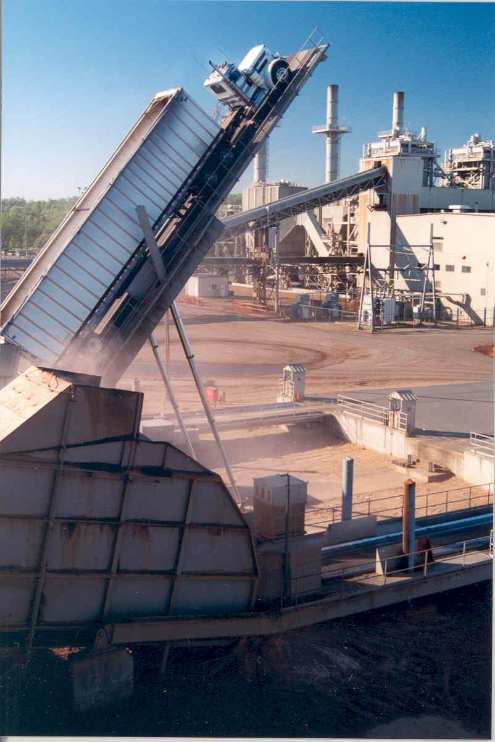
Improvement 3 – Access to Other Power Markets
California market most lucrative in U.S.
California utilities have delivery points in Las Vegas area and at Intermountain Power
Local utility must value firmness, voltage control, elimination of losses
Local sale through Deseret G&T in Ely area

Slide 6

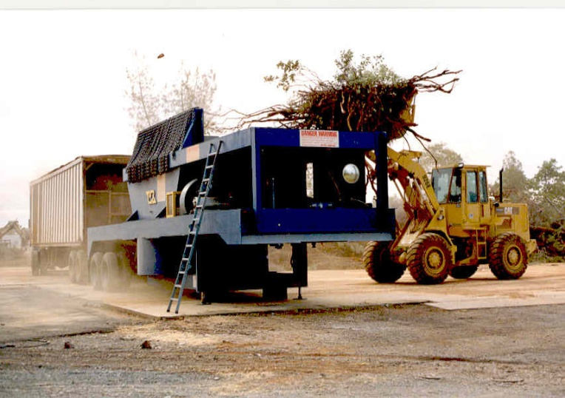
Improvement 4 – Enhanced Federal Incentives
Extension of 30% federal grant vs. use of Production Tax Credit
Full PTC for biomass vs. current ½
Credit for combined heat and power through federal RPS, Section 48 Tax Credit
Biomass definition that allows use of P-J restoration products

Slide 7
Improvement 5 – Develop a Thermal Customer
Characteristics of good customer
  Takes >10% heat rejected from T-G
  Takes low pressure steam or hot water
  Has limited seasonality, day of week variations
  Will be there for long term
  Has acceptable credit
Such a customer raised fuel value to $36/BDT
Ore roasting, prison, “green” industrial park

Slide 8
Improvement 6 – Enhanced Financing Package
Federal direct loan best outcome (USDA, RUS)
Potential application of New Market Tax Credits (Ely)
Nevada allows industrial development revenue bond sales
Need to obtain early construction financing
Need to drop equity below 30%
  (20% equity raises fuel price to $36)
Any financing package will require ironclad fuel availability

Slide 9
Conclusion
With the status quo, a moderate sized P-J biomass power facility cannot afford to pay full restoration cost, but can contribute above the cost for fuel chipping/transport. Other users or changes needed to approach full restoration cost recovery.

